Slide 1
دانشگاه علوم پزشکی تبریز
دانشکده دندانپزشکی
دیماه 1399

Slide 2
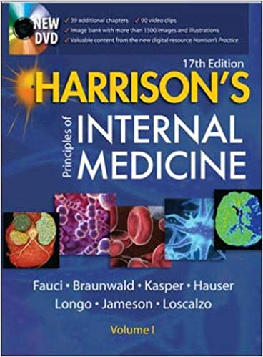
2019 / Harrison's Principles of Internal Medicine
تازه های کتاب 99

Slide 3
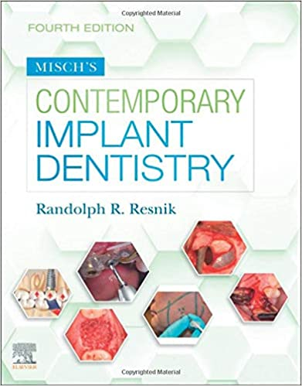
Misch's Contemporary Implant Dentistry / 2020
تازه های کتاب 99

Slide 4
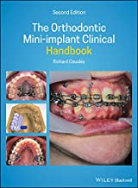
The Orthodontic Mini-implant Clinical Handbook / 2020
تازه های کتاب 99

Slide 5
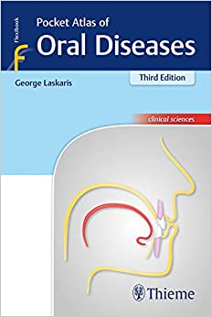
2019 / Pocket Atlas of Oral Diseases 3rd Edition
تازه های کتاب 99

Slide 6
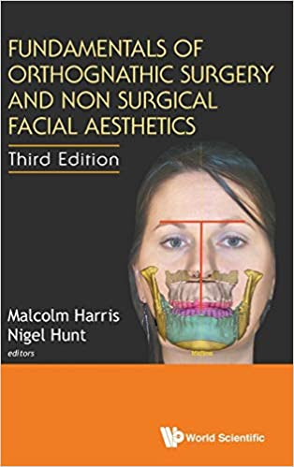
Fundamentals of Orthognathic Surgery and Non Surgical 2018 / Facial Aesthetics
تازه های کتاب 99

Slide 7
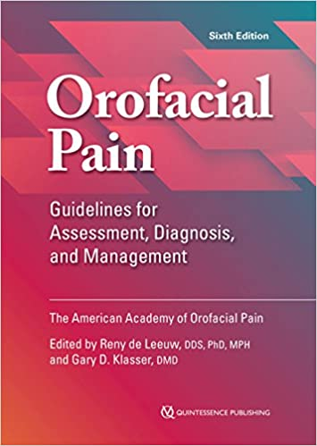
Orofacial Pain: Guidelines for Assessment, Diagnosis, 2018 / and Management
تازه های کتاب 99

Slide 8
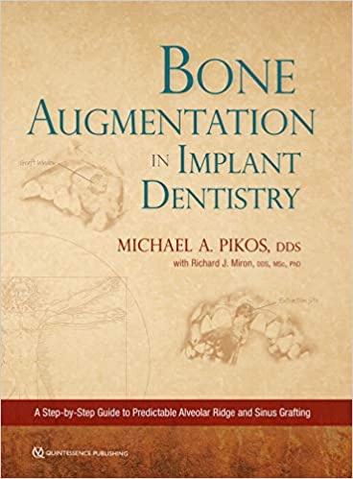
Bone Augmentation in Implant Dentistry: A Step-by-Step Guide to Predictable Alveolar Ridge and Sinus Grafting / 2019
تازه های کتاب 99

Slide 9
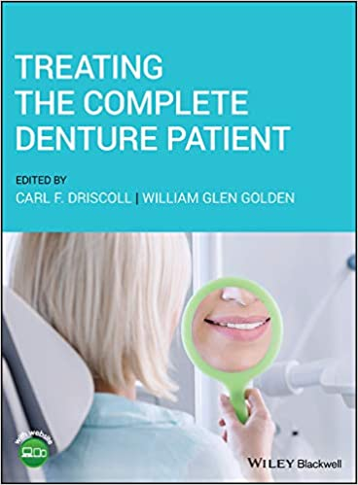
Treating the Complete Denture Patient 1st Edition / 2020
تازه های کتاب 99

Slide 10
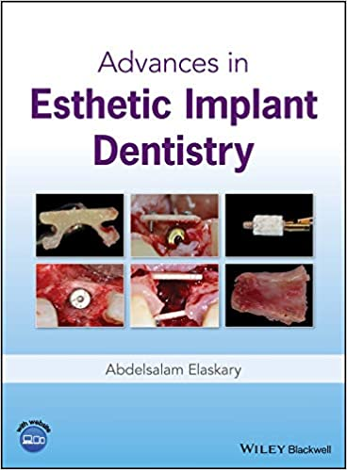
Advances in Esthetic Implant Dentistry 1st Editiony / 2018
تازه های کتاب 99

Slide 11
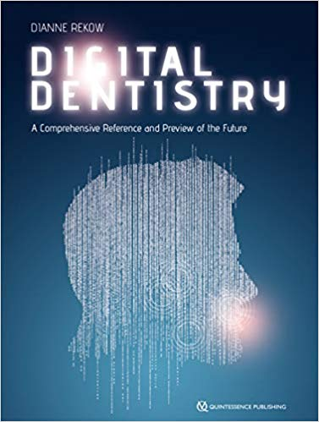
Digital Dentistry: A Comprehensive Reference and Preview of the Future 1st Edition / 2018
تازه های کتاب 99

Slide 12
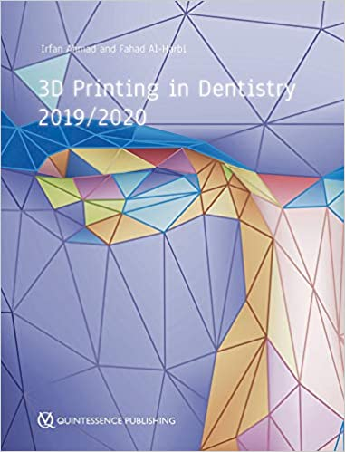
2019/ 3D Printing in Dentistry 1st Edition
تازه های کتاب 99

Slide 13
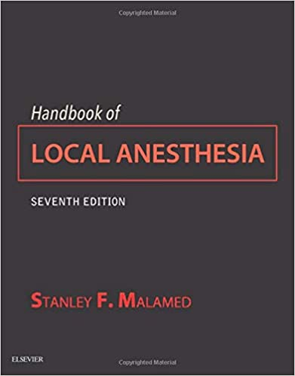
Handbook of Local Anesthesia 7th Edition / 2020
تازه های کتاب 99

Slide 14
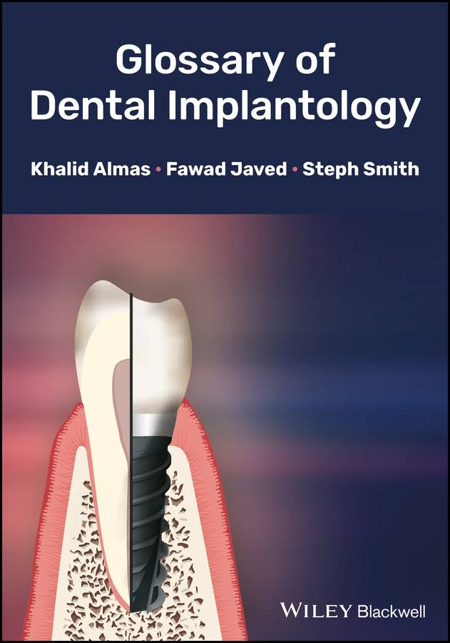
Glossary of Dental Implantology / 2018
تازه های کتاب 99

Slide 15
Essential Endodontology: Prevention and Treatment of Apical Periodontitis, 3rd Edition / 2020
تازه های کتاب 99

Slide 16
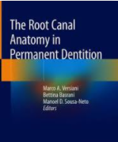
The root canal anatomy in permanent dentition / 2019
تازه های کتاب 99

Slide 17
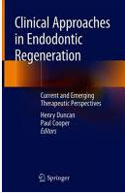
Clinical Approaches in Endodontic Regeneration / 2019
تازه های کتاب 99

Slide 18
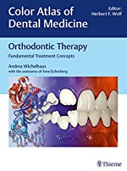
Orthodontic Therapy: Fundamental Treatment Concepts (Color Atlas of Dental Medicine) 1st Edition / 2018
تازه های کتاب 99

Slide 19
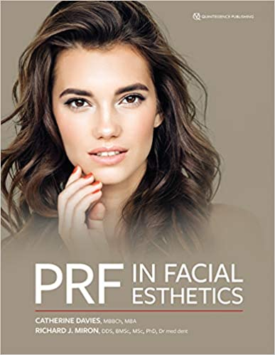
PRF in Facial Esthetics 1st Edition / 2020
تازه های کتاب 99

Slide 20
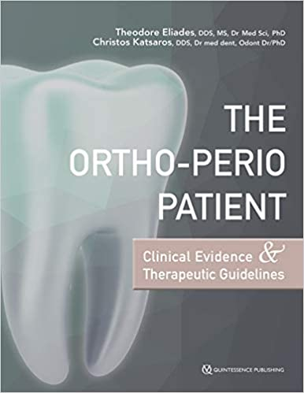
The Ortho-Perio Patient: Clinical Evidence & Therapeutic Guidelines 1st Edition / 2019
تازه های کتاب 99

Slide 21
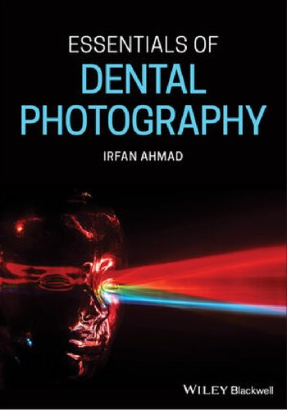
Essentials of Dental Photography / 2019
تازه های کتاب 99

Slide 22
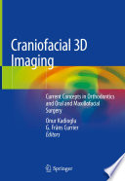
Craniofacial 3D Imaging: Current Concepts in Orthodontics and 2019 / oral and Maxillofacial Surgery
تازه های کتاب 99

Slide 23
Postgraduate Notes in Orthodontics 8th Edition / 2019
تازه های کتاب 99

Slide 24
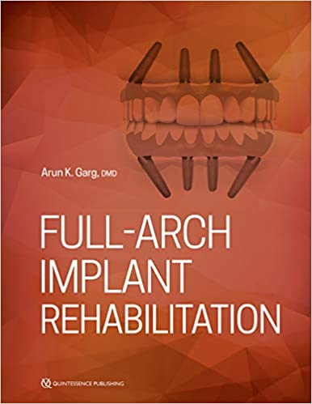
Full-Arch Implant Rehabilitation 1st Edition
by Arun K. Garg/ 2019
تازه های کتاب 99

Slide 25
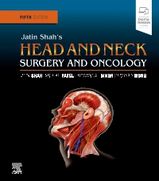
Jatin Shah's Head and Neck Surgery and Oncology, 5th 2020 / Edition by Jatin P. Shah
تازه های کتاب 99

Slide 26
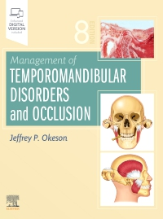
Management of Temporomandibular Disorders and occlusion, 8th Edition by Jeffrey P. Okeson
تازه های کتاب 99

Slide 27
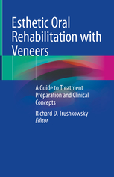
2020/ Veneers Esthetic Oral Rehabilitation with
تازه های کتاب 99

Slide 28
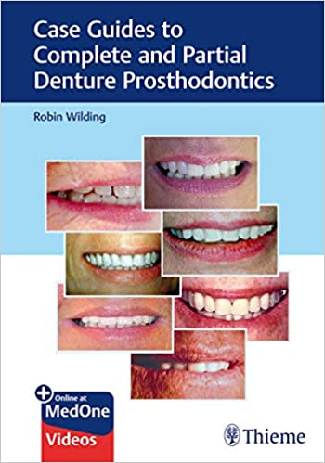
Case Guides to Complete and Partial Denture prosthodontics
1st Edition by Robin Wilding / 2019
تازه های کتاب 99

Slide 29
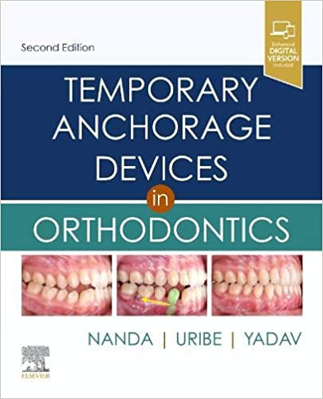
Temporary Anchorage Devices in Orthodontics 2nd Edition
by Ravindra Nanda / 2021
تازه های کتاب 99

Slide 30
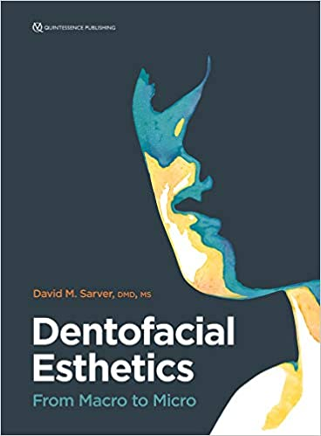
Dentofacial Esthetics: From Macro to Micro / 2020
تازه های کتاب 99

Slide 31
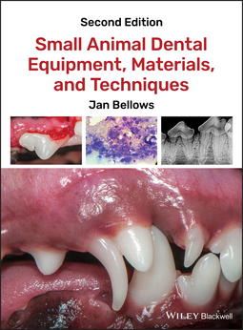
Small Animal Dental Equipment, Materials, and Techniques by Bellows, Jan / 2019
تازه های کتاب 99

Slide 32
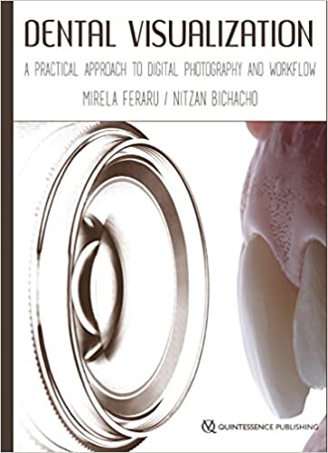
Dental Visualization: A Practical Approach to Digital Photography and Workflow 1st Edition
by Mirela Feraru;Nitzan Bichacho / 2018
تازه های کتاب 99

Slide 33
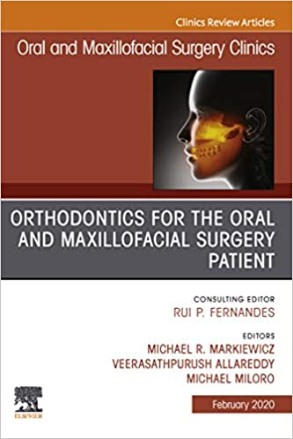
Orthodontics for Oral and Maxillofacial Surgery Patient, An Issue of Oral and Maxillofacial Surgery Clinics of North America
by Michael R. Markiewicz/ 2020
تازه های کتاب 99

Slide 34
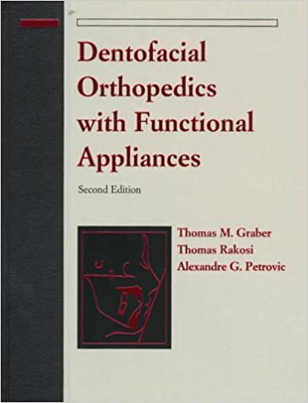
Dentofacial Orthopedics with Functional Appliances 2nd Edition by Thomas M. Graber / 1997
تازه های کتاب 99

Slide 35
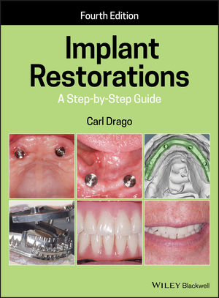
Implant Restorations: A Step-by-Step Guide, 4th Edition by Carl Drago / 2020
تازه های کتاب 99

Slide 36
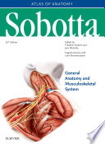
Sobotta Atlas of Anatomy/ 2018
تازه های کتاب 99

Slide 37
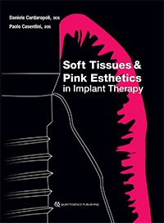
Soft Tissues and Pink Esthetics in Implant Therapy/ 2020
تازه های کتاب 99

Slide 38
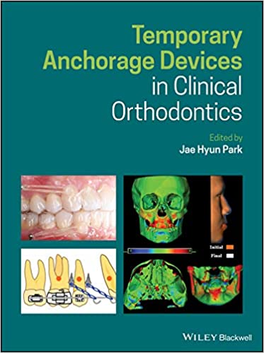
Temporary Anchorage Devices in Clinical Orthodontics
1st Edition by Jae Hyun Park / 2020
تازه های کتاب 99

Slide 39
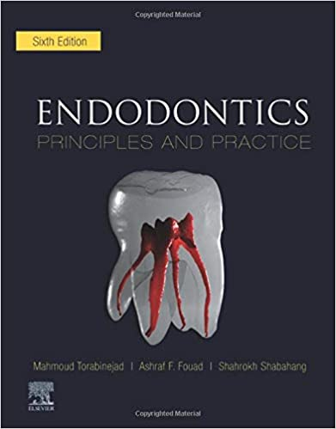
Endodontics: Principles and Practice 6th Edition
by Mahmoud Torabinejad/ 2021
تازه های کتاب 99

Slide 40
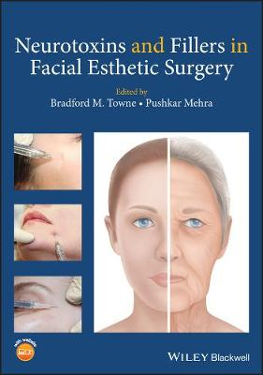
Neurotoxins and Fillers in Facial Esthetic Surgery
by Bradford M. Towne/ 2019
تازه های کتاب 99

Slide 41
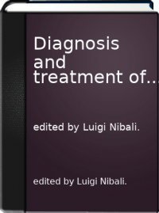
Diagnosis and treatment of furcation-involved teeth /
by Luigi Nibali / 2018
تازه های کتاب 99

Slide 42
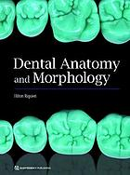
Dental anatomy and morphology by Hilton Riquieri/ 2018
تازه های کتاب 99

Slide 43
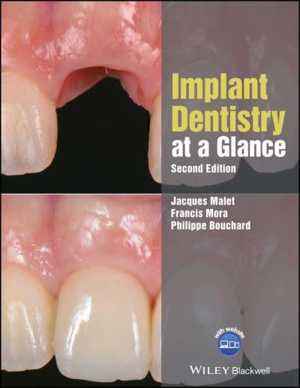
Implant Dentistry at a Glance - At a Glance (Dentistry) by Jacques Malet / 2018
تازه های کتاب 99

Slide 44
ZERO BONE LOSS CONCEPTS / 2020
تازه های کتاب 99

Slide 45
The Ortho-Perio Patient: Clinical Evidence & Therapeutic Guidelines 1st Edition by Theodore Eliades / 2019
تازه های کتاب 99

Slide 46
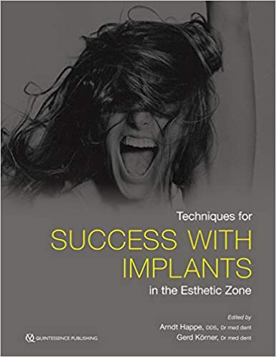
Techniques for Success with Implants in the Esthetic Zone 1st Edition by Arndt Happe / 2019
تازه های کتاب 99

Slide 47
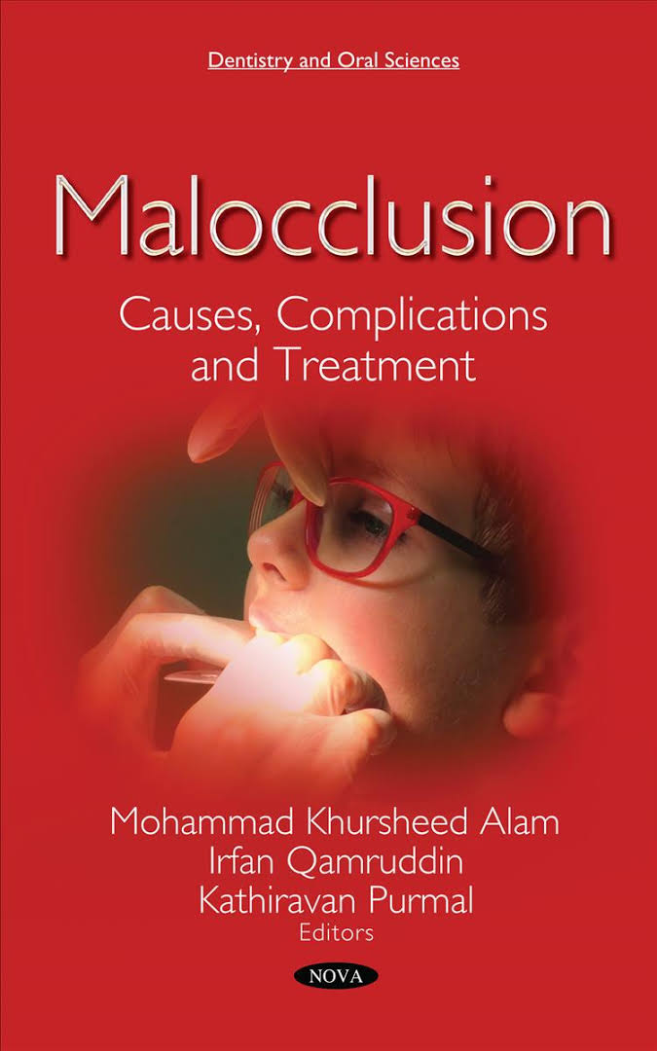
Malocclusion: Causes, Complications and Treatment by Kathiravan Purmal / 2018
تازه های کتاب 99

Slide 48
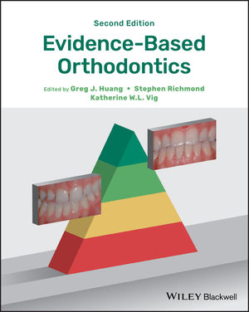
Evidence-Based Orthodontics, 2nd Edition
by Greg J. Huang / 2018
تازه های کتاب 99

Slide 49
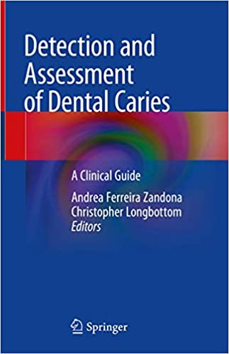
Detection and Assessment of Dental Caries: A Clinical Guide 1st ed. 2019 Edition by Andrea Ferreira Zandona / 2019
تازه های کتاب 99

Slide 50
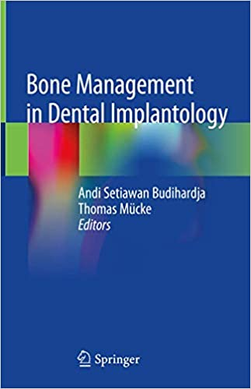
Bone Management in Dental Implantology 1st ed. 2019 Edition by Andi Setiawan Budihardja / 2019
تازه های کتاب 99

Slide 51
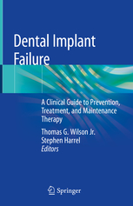
Dental Implant Failure: A Clinical Guide to Prevention, Treatment, and Maintenance Therapy by Wilson, Thomas G / 2019
تازه های کتاب 99

Slide 52
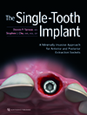
The Single-Tooth Implant: A Minimally Invasive Approach for Anterior and Posterior Extraction Sockets by Tarnow, Dennis P./ 2020
تازه های کتاب 99

Slide 53
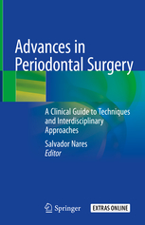
Advances in Periodontal Surgery: A Clinical Guide to Techniques and Interdisciplinary Approaches
By Nares, Salvador / 2020
تازه های کتاب 99

Slide 54
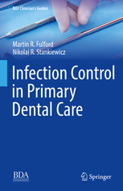
Infection Control in Primary Dental Care
by Fulford, Martin Roger/ 2020
تازه های کتاب 99

Slide 55
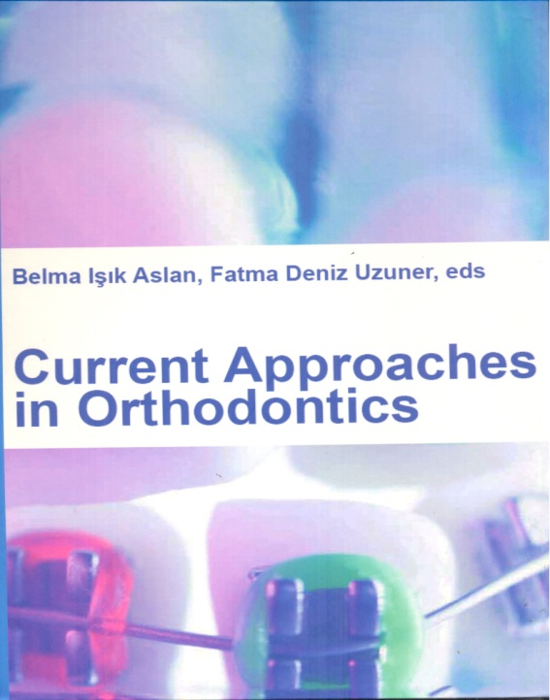
Current Approaches in Orthodontics by Fatma Deniz Uzuner / 2019
تازه های کتاب 99

